Slide 1
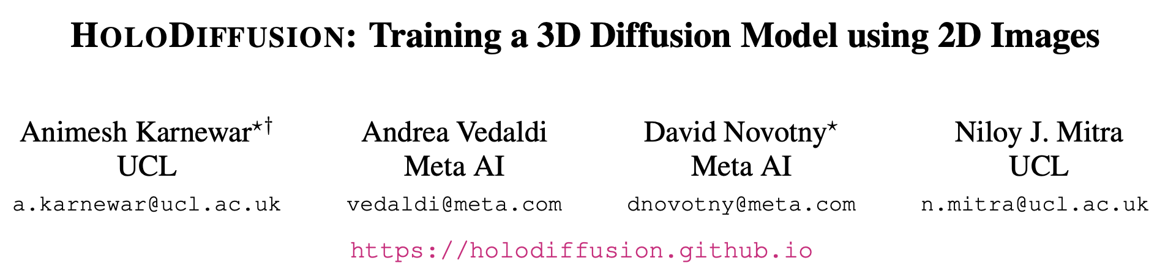
CVPR 2023
Citations: 57
Source: https://holodiffusion.github.io/

Slide 2
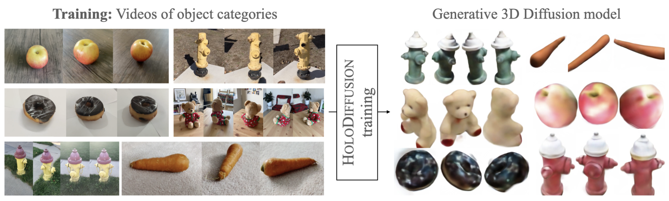
Diffusion → generative modeling of 2D images
large quantity of 3D training data
memory and compute complexity
No standard representation
Non-standard co-ordinate frames
only posed 2D images for supervision
decouples model memory from spatial memory
Notes:
lack of a sufficient volume of 3D data for training
choice of representation ?
different views of the same object with known cameras

Slide 3
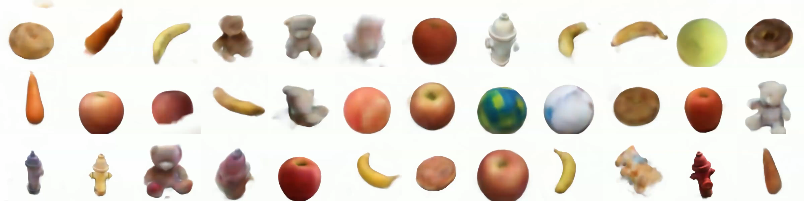

Slide 4
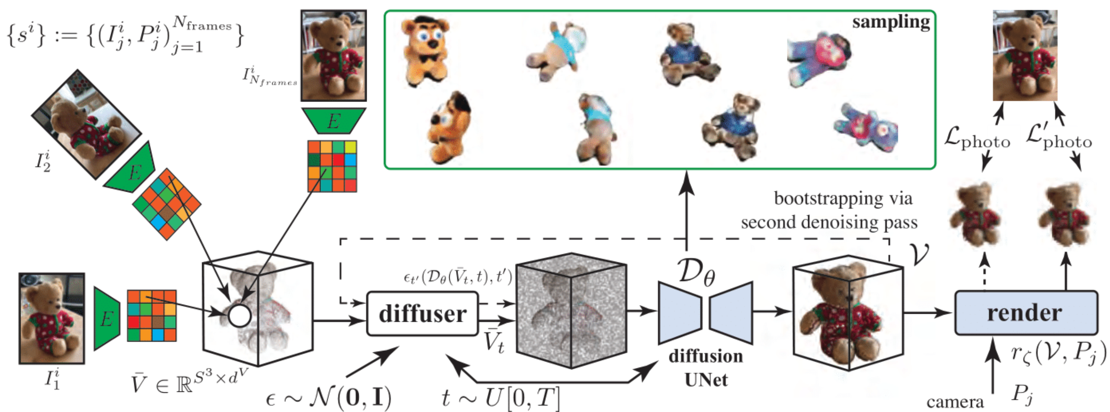

Slide 5
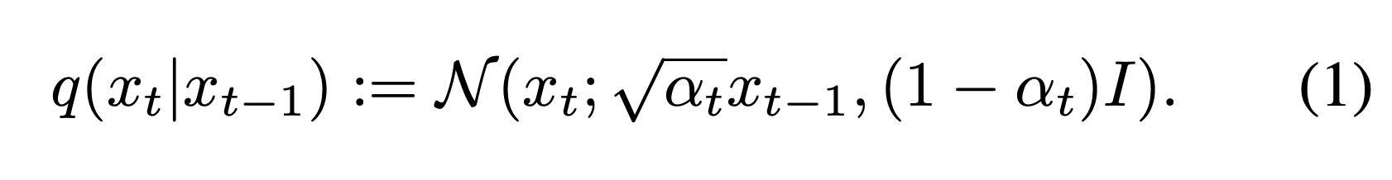
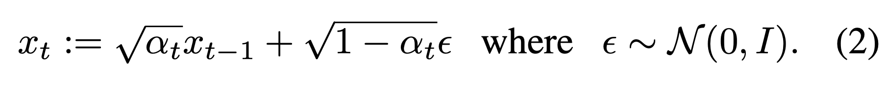
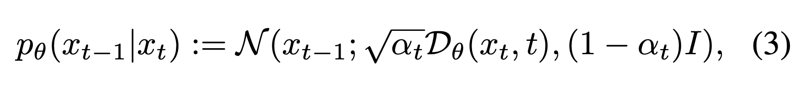
Denoising Diffusion Probabilistic Model → noising transitions (using a Gaussian distribution)
Samples → reparameterization trick
reverse denoising (using a Gaussian distribution)

Slide 6
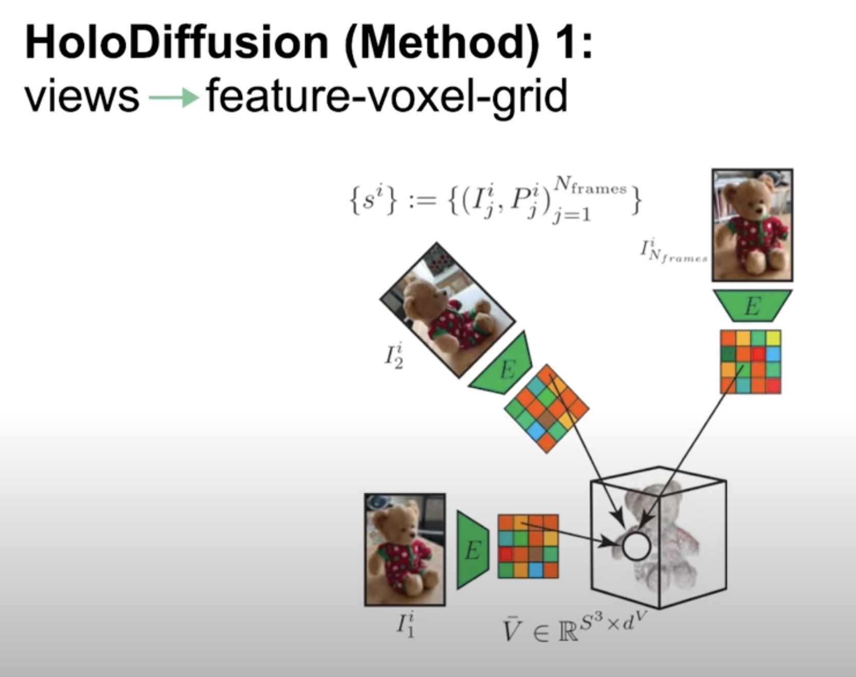

Slide 7
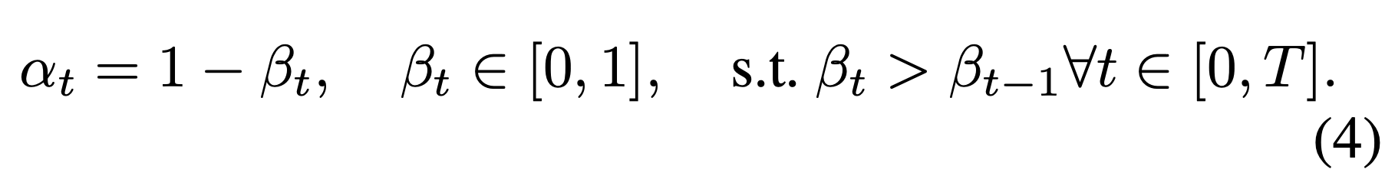
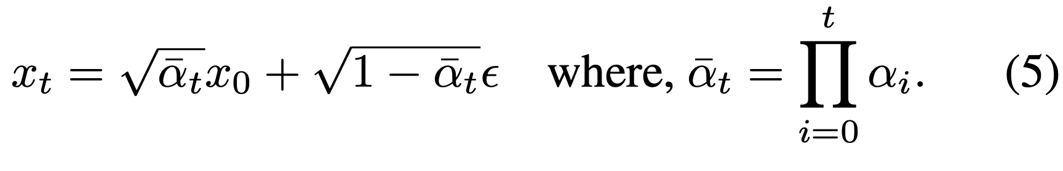
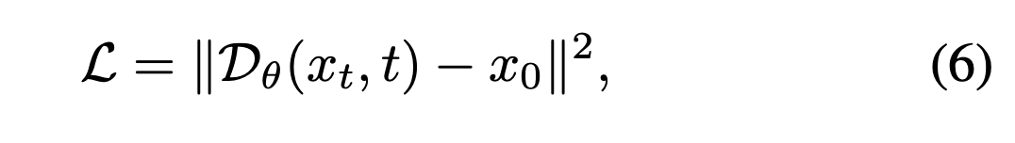
Noise schedule
Training

Slide 8
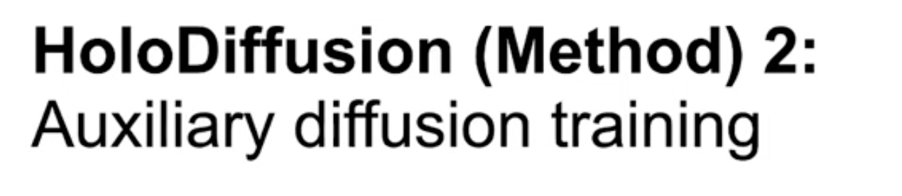
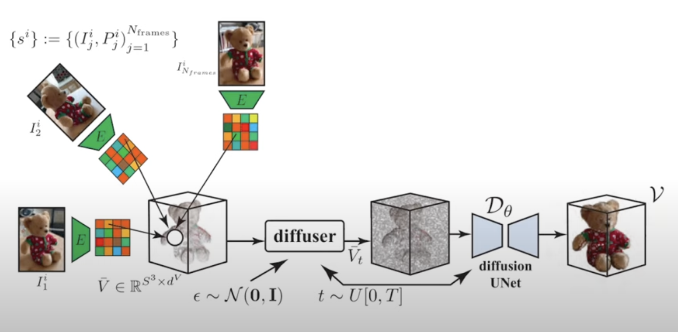

Slide 9
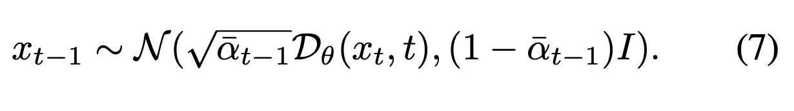
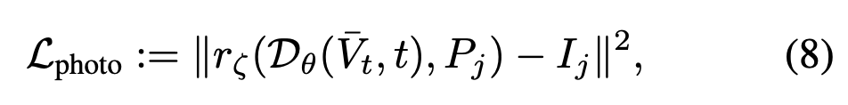
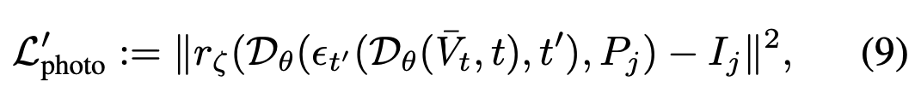
Sampling
Photometric loss
Bootstrapped photometric loss

Slide 10
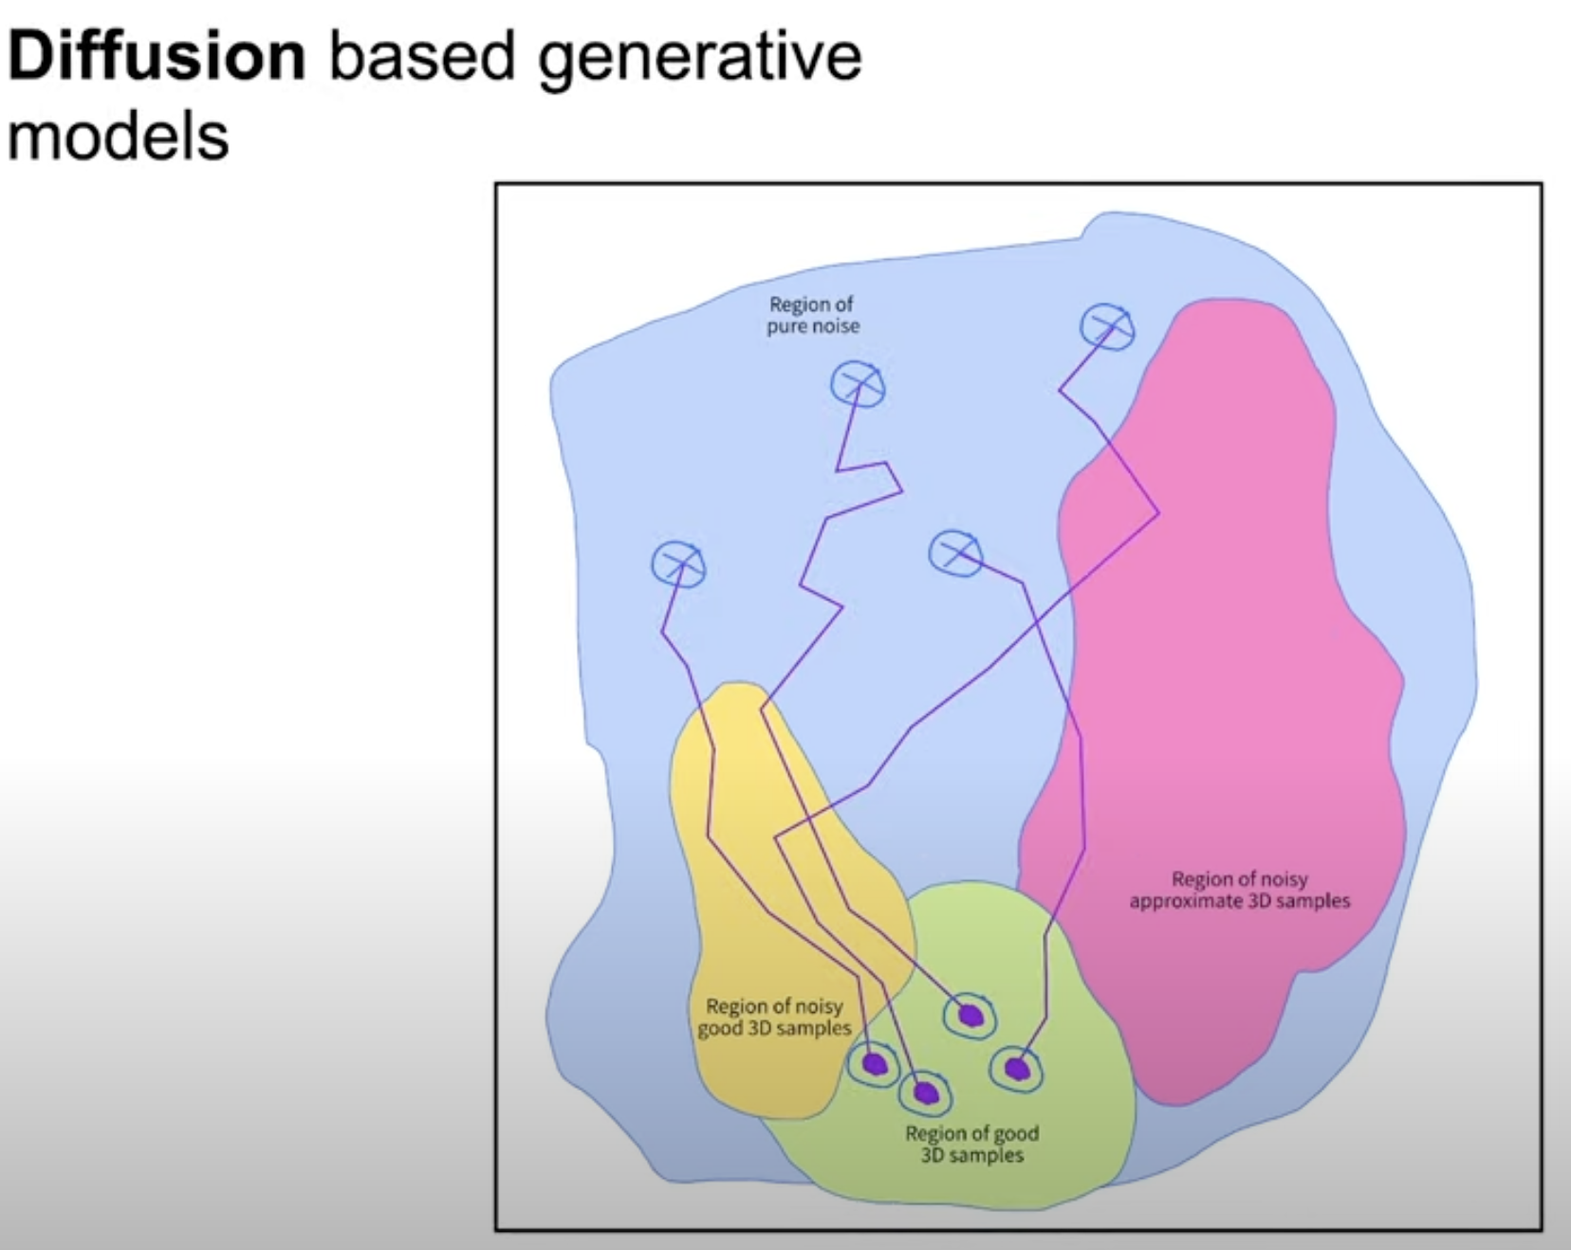
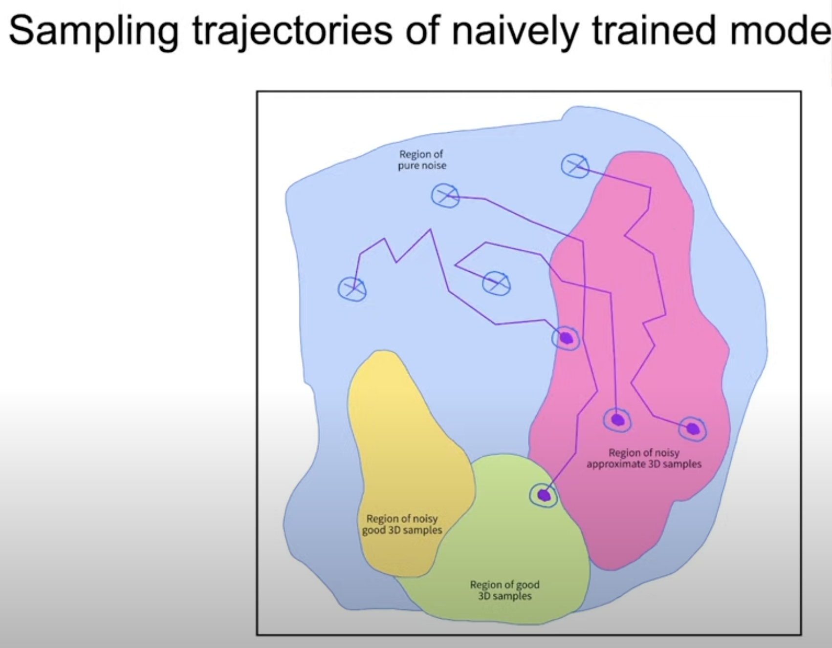
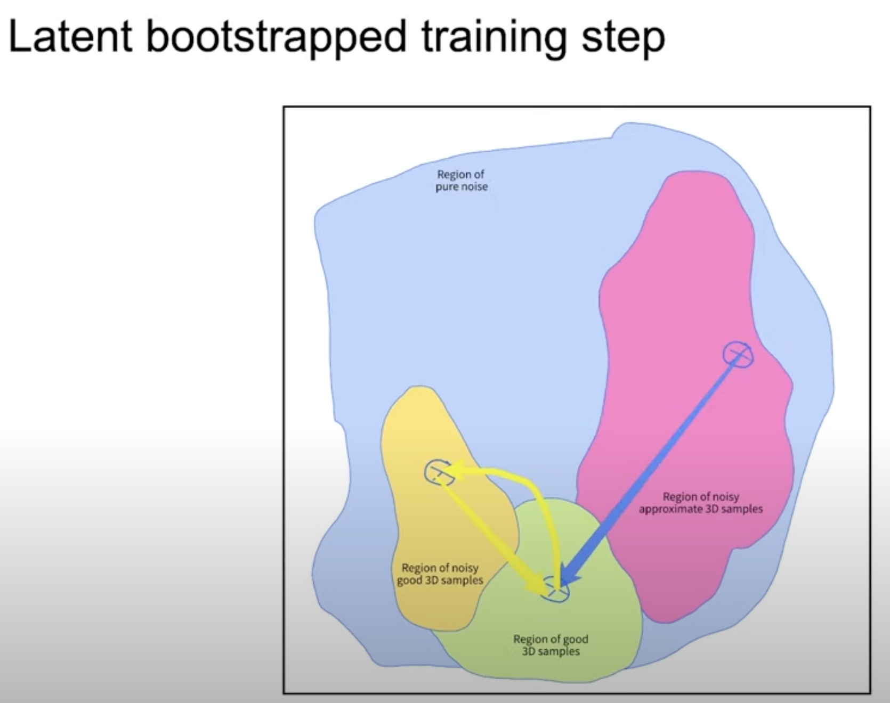
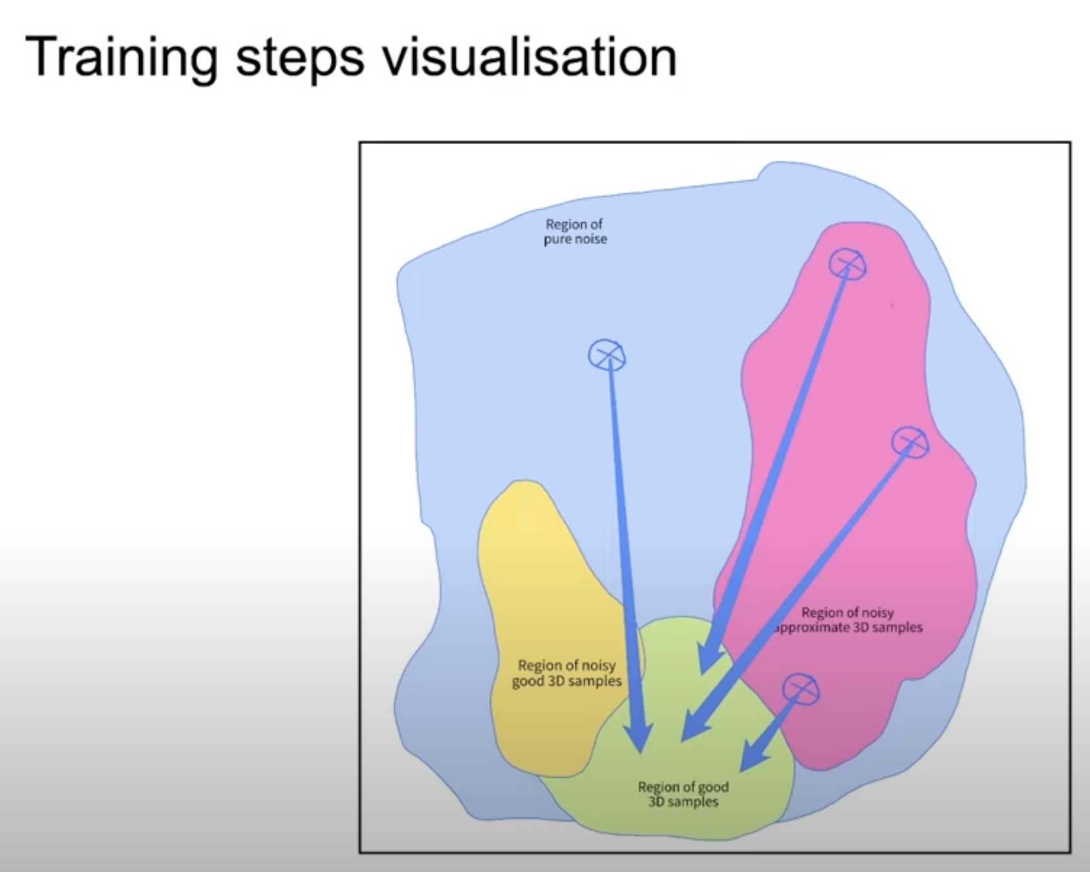
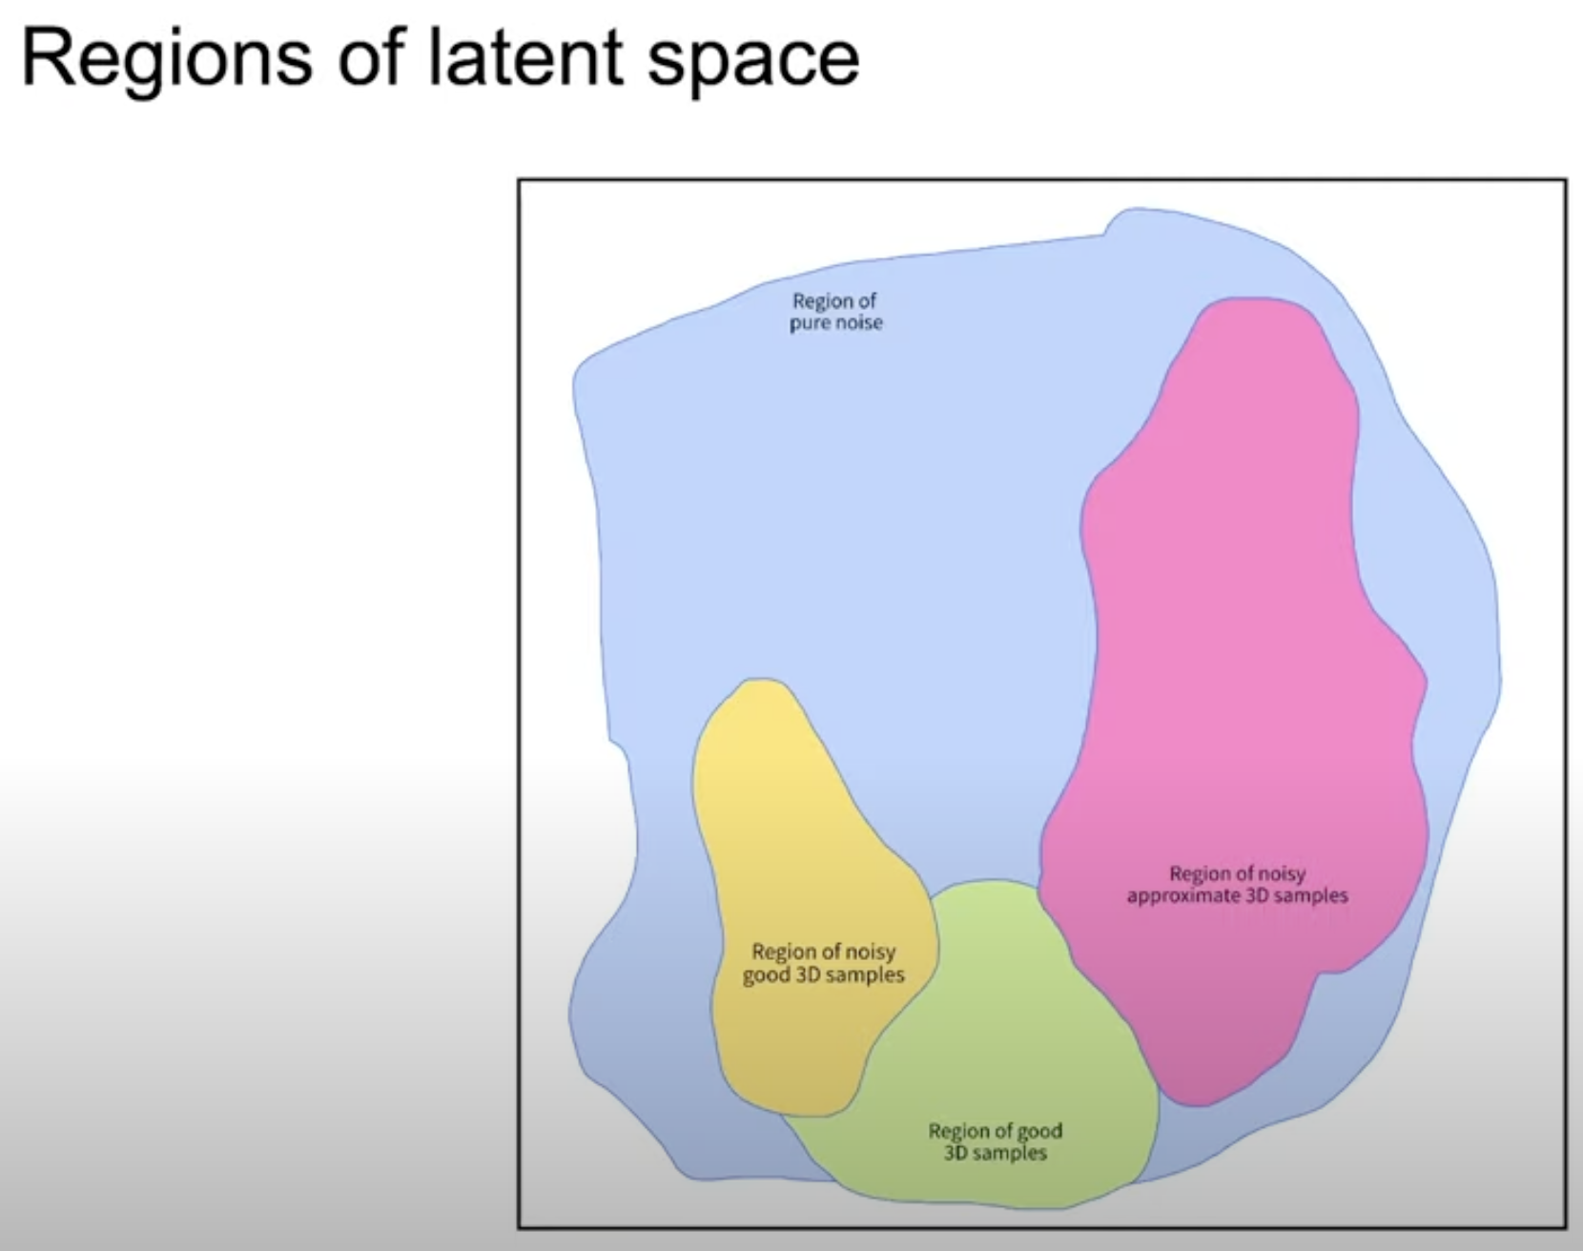
HOLODIFFUSION

Slide 11
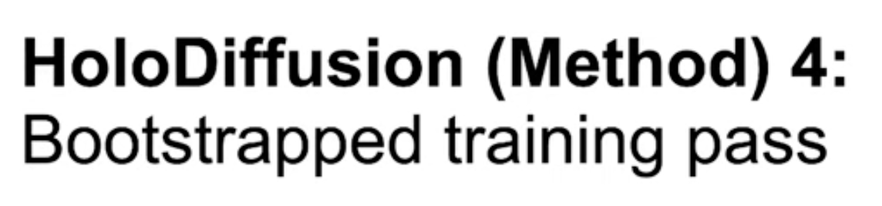
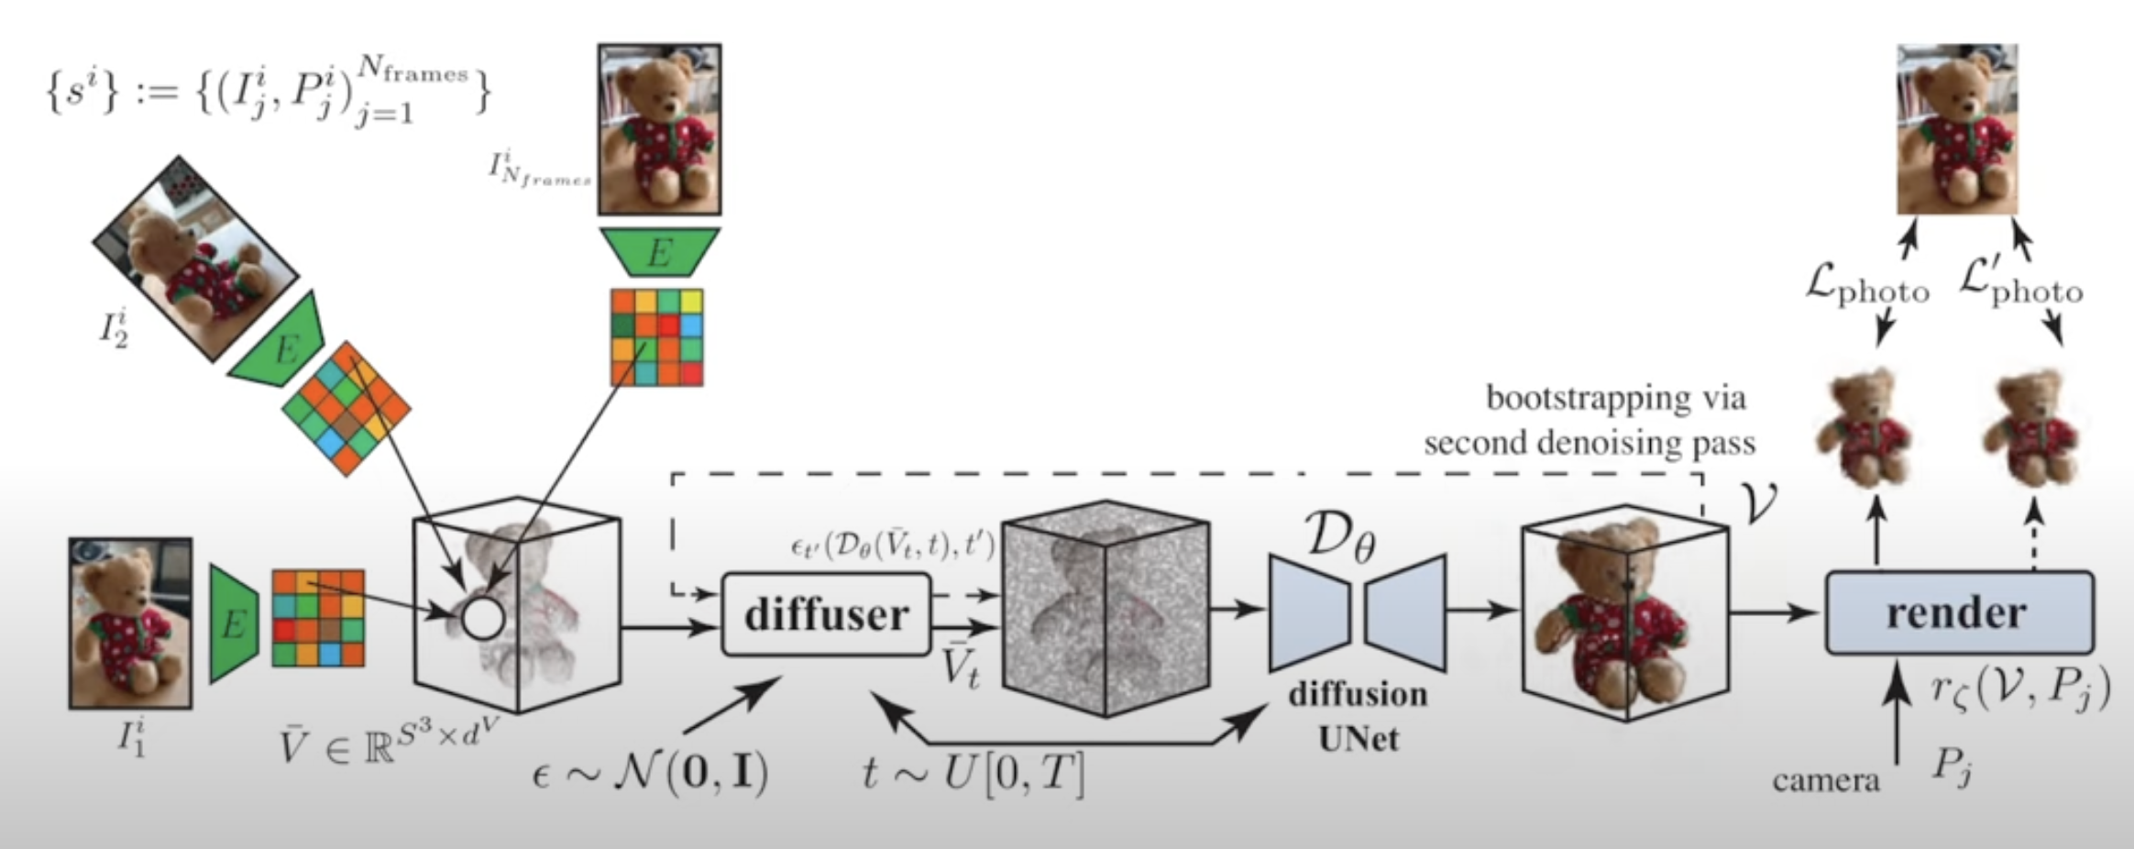

Slide 12
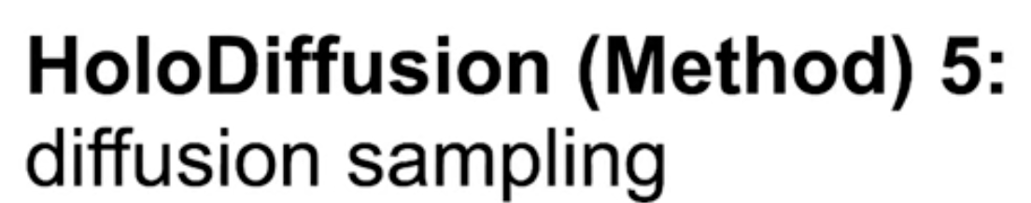

Slide 13
Experiments: Datasets and baselines
CO3Dv2
fly-around real-life videos
complete circle around the object
camera poses
object foreground masks
Apple, Hydrant, TeddyBear and Donut
500 “train” videos
2-to-8 V100 32GB GPUs for 2 weeks
pi-GAN, EG3D, and GET3D
Frechet Inception Distance (FID)
Kernel Inception Distance (KID)

Slide 14
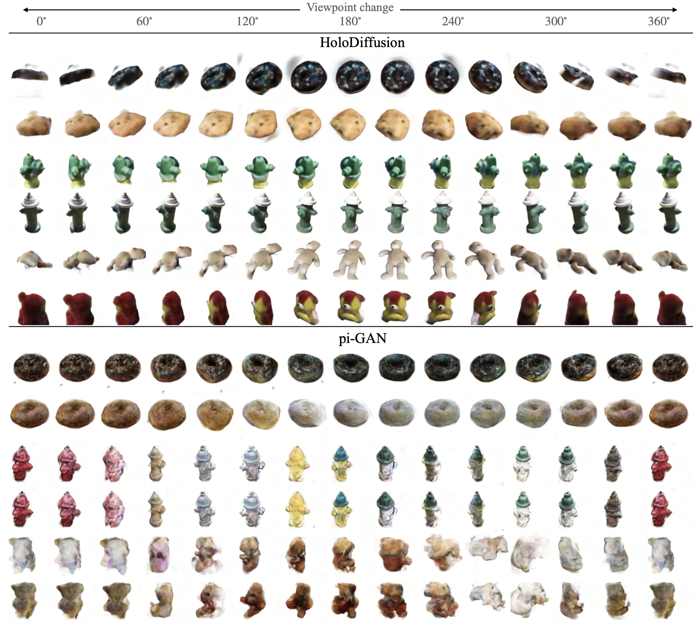

Slide 15
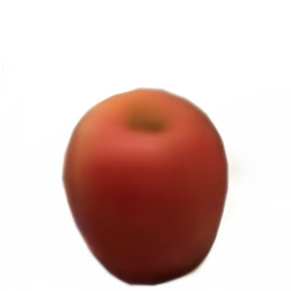
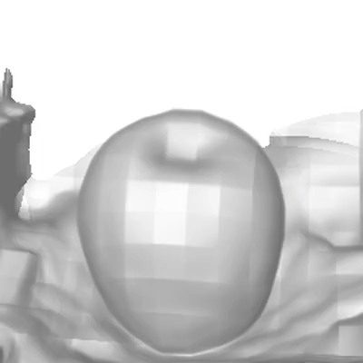
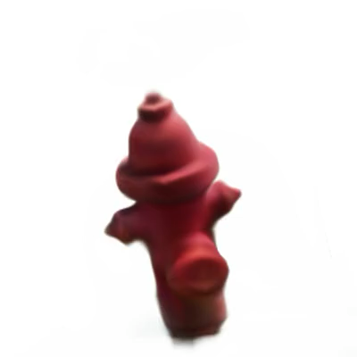
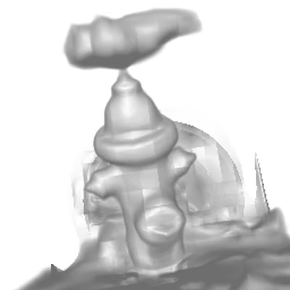
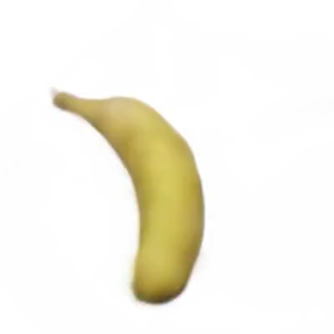
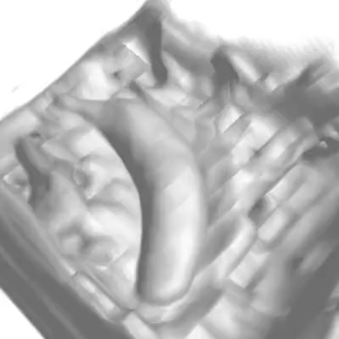
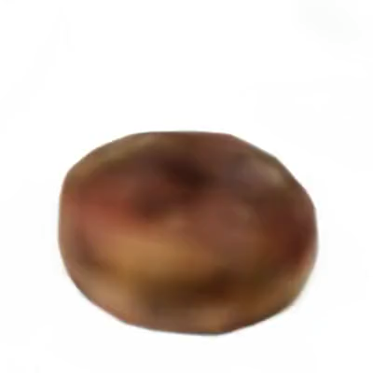
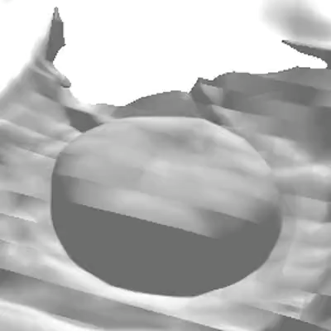

Slide 16
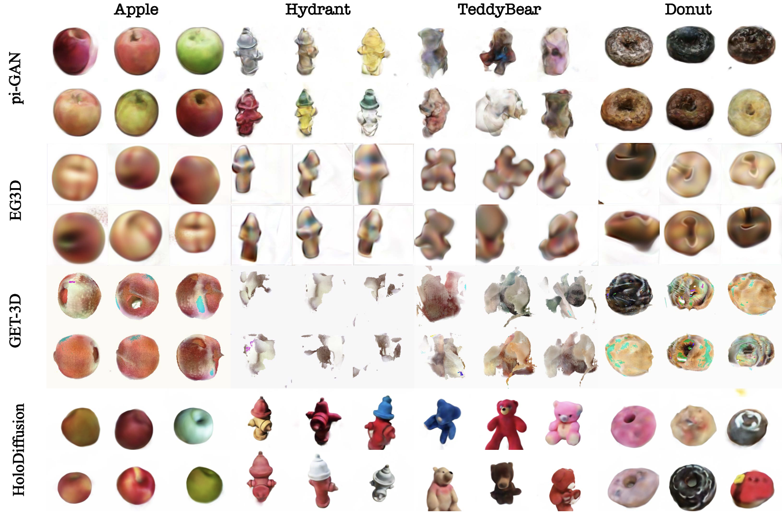
produces the most appealing, consistent and realistic samples

Slide 17
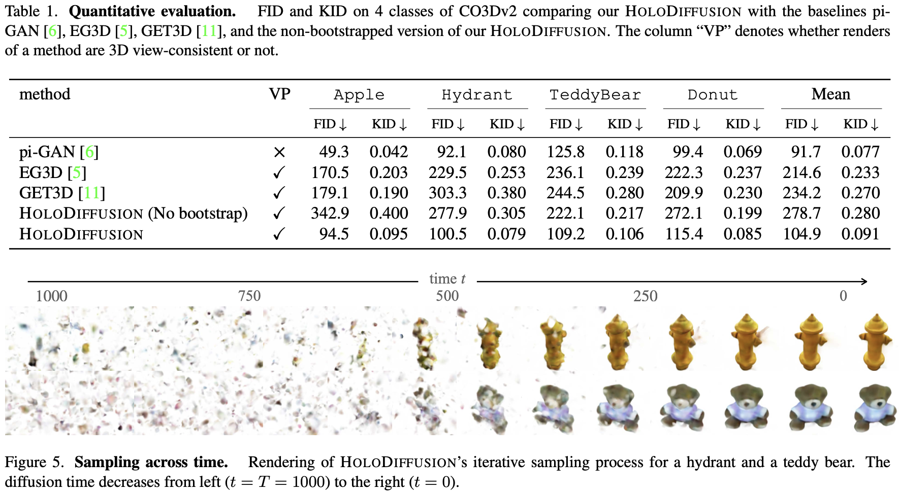

Slide 18
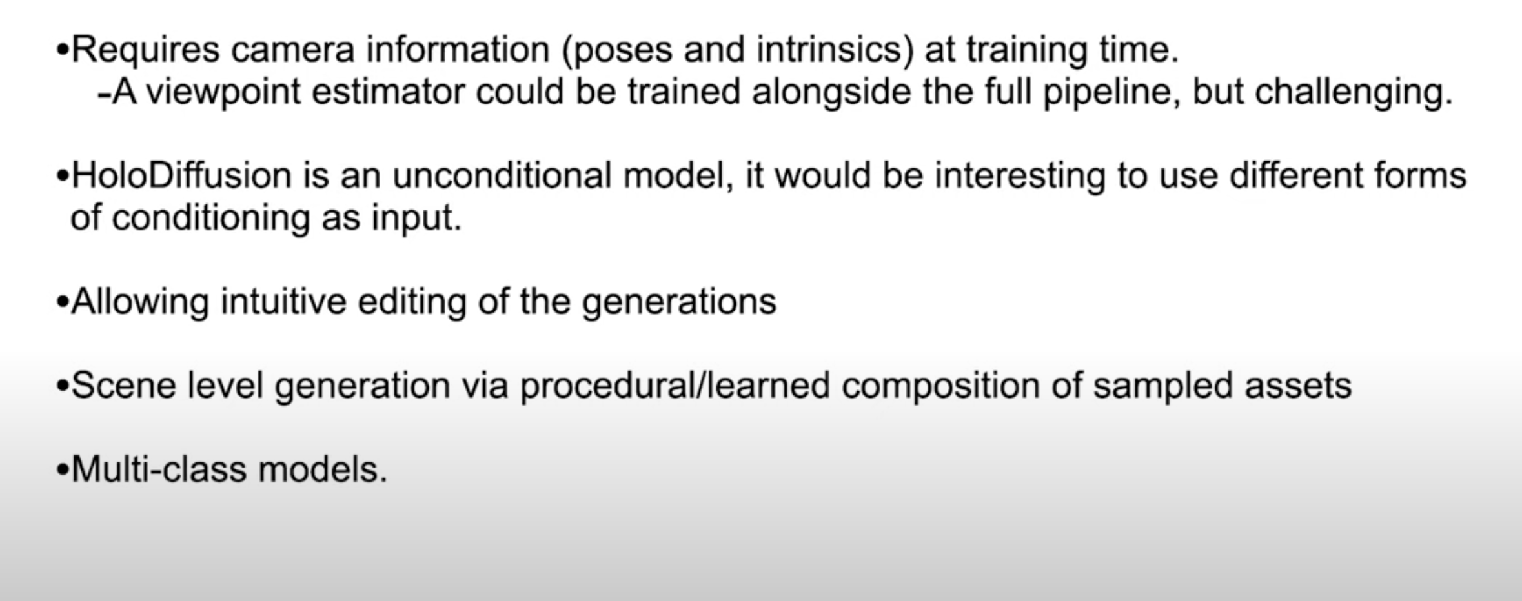
Limitations and future work

Slide 19
Q&A

